Slide 1
Internship Presentation
Android App Development using GenAI
INTERNSHIP (Subject Code BIS803) by Srajan| 1HK22IS018 VIII Semester: B.E (ISE) 2025-26 Internal Guide: Prof. x External Guide: Mr. Tirumal Mutalikdesai, MindMatrix.io

Slide 2
ORGANIZATIONAL INFRASTRUCTURE
Digital Infrastructure:
MindMatrix operates on a cloud-based LMS platform (lms.mindmatrix.io) with AI-powered personalized learning, real-time progress tracking, and mobile-responsive interfaces. The infrastructure is scalable and secure, supporting 10,000+ active learners with advanced analytics capabilities.
Technology Stack:
• Kotlin & Jetpack Compose for modern Android development
• Firebase & Google Cloud Platform for backend services
• Salesforce integration for enterprise solutions
• Generative AI (Gemini) for intelligent features
• Cloud-based deployment and monitoring systems
Team Structure:
• Founder & CEO: Sujit Kumar (Vision, Strategy, Growth)
• Technical Team: Platform development and maintenance
• Training & Development Team: Curriculum design and course creation
• Internship Mentors: Student guidance and project support
• Student Community: 10,000+ active learners

Slide 3
PRODUCTS AND SERVICES
Core Products:
• Cloud-based LMS Platform with AI-powered personalization
• Industry-aligned technical courses in Android Development
• Generative AI integration training programs
• Enterprise-grade cloud solutions
• Real-world project labs and hands-on modules
Premium Services:
• Expert mentorship programs with industry professionals
• Hands-on real-world projects with actual client requirements
• Internship & placement support with 500+ industry partners
• Career guidance and professional portfolio development
• Skill assessments and industry certifications
Partnerships:
• 150+ partner academic institutions across India
• 500+ industry partners for placements and projects
• Strategic tech company collaborations for curriculum design
• Direct industry exposure and networking opportunities

Slide 4
COMPANY PROFILE
Company Overview:
MindMatrix.io (CL Infotech Pvt. Ltd.) was established in 2018 with a vision to transform higher education through technology. Headquartered in Bangalore, Karnataka, the company specializes in AI-powered career development and personalized learning platforms.
Expertise & Focus:
• AI-powered personalized learning platforms
• Industry-aligned training for engineering students
• Android development and Generative AI specialization
• Bridging gap between academic and industry requirements
• Student-to-professional development programs
Scale & Impact:
• Trained 10,000+ students successfully
• Partners with 150+ academic institutions
• Collaborates with 500+ industry partners
• Recognized as top academia-industry bridge platform (2023)
• Operating with 2-10 dedicated team members

Slide 5
COMPANY JOURNEY
2018-2020:
• 2018: MindMatrix.io launched with transforming education vision
• 2019: Successfully trained 1000+ students across 10 institutions
• 2020: Established MindMatrix Labs for innovation and research
2021-2023:
• 2021: Partnered with 100+ leading companies for placements
• 2022: Launched LaunchPad Initiative for student entrepreneurs
• 2023: Recognized as top academia-industry bridge platform nationally
2024 & Beyond:
• Integrated advanced AI-powered learning paths
• Continuing expansion of industry partnerships
• Building community of industry-ready professionals

Slide 6
OBJECTIVES OF THE INTERNSHIP
Primary Objectives:
• Master Android app development with Kotlin and Jetpack Compose for production-ready applications
• Learn integration of Generative AI capabilities into mobile applications using modern frameworks
• Gain hands-on experience with industry-standard tools and cloud platforms for enterprise development
• Understand modern app architecture patterns and best practices followed in corporate environments
• Build professional portfolio with multiple production-ready applications demonstrating technical expertise
Technical Competencies:
• Develop networking capabilities with REST APIs and async data handling
• Create responsive UI designs with Jetpack Compose following Material Design principles
• Implement concurrent programming with Kotlin Coroutines for efficient resource management
• Master cloud platform integration (Google Cloud, Salesforce, Firebase)
Career Goals:
• Prepare for industry-ready Android development positions
• Develop professional communication and collaboration skills
• Build marketable portfolio demonstrating complete feature development capabilities

Slide 7
LEARNING EXPERIENCES (FOUNDATION & KOTLIN PROGRAMMING)
Platform Onboarding & Fundamentals:
The internship began with mastering the MindMatrix portal and configuring Google Cloud Platform environments. Badge-based learning modules established foundational knowledge, and Kotlin programming was progressively learned from basic logic to advanced object-oriented concepts.
Programming Concepts:
• Data classes, higher-order functions, and polymorphism
• Functional programming paradigms in Kotlin
• Error handling and null safety features
• Design patterns for scalable code architecture
Console Applications:
Practical projects included building tip calculators, contact managers, and inventory systems. These projects reinforced design patterns and established the foundation for advanced mobile development.

Slide 8
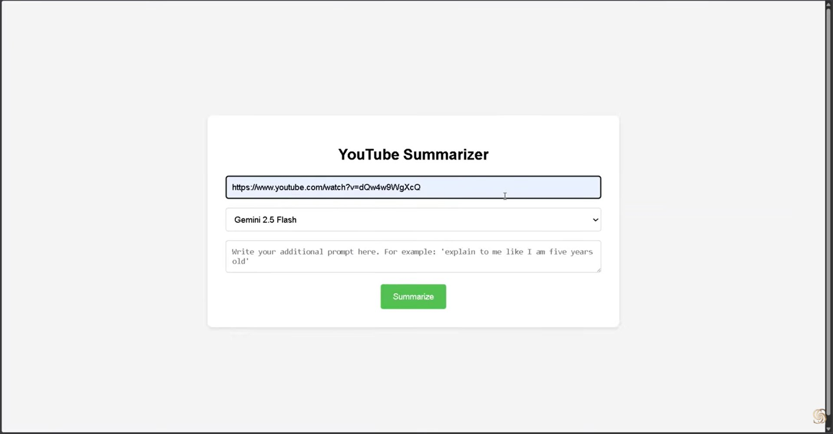
PROJECT: YOUTUBE SUMMARIZER (GOOGLE CLOUD PLATFORM & GENERATIVE AI)
Developed a comprehensive cloud-based application leveraging Google Cloud infrastructure and Generative AI capabilities. The project involved provisioning GCP resources, enabling critical APIs including Vertex AI, Cloud Run, Cloud Build, and Cloud Resource Manager for authentication and infrastructure management. A Python Flask web application was created with custom HTML frontend and backend logic. The application analyzes YouTube video transcripts using the Gemini AI engine and generates concise, accurate summaries. The system was successfully deployed and tested using Cloud Shell web preview, demonstrating practical integration of cloud services with AI technologies. Key learnings: Cloud infrastructure management, secure API key handling, Python Flask development, end-to-end cloud deployment, and practical Generative AI integration in production applications.

Slide 9
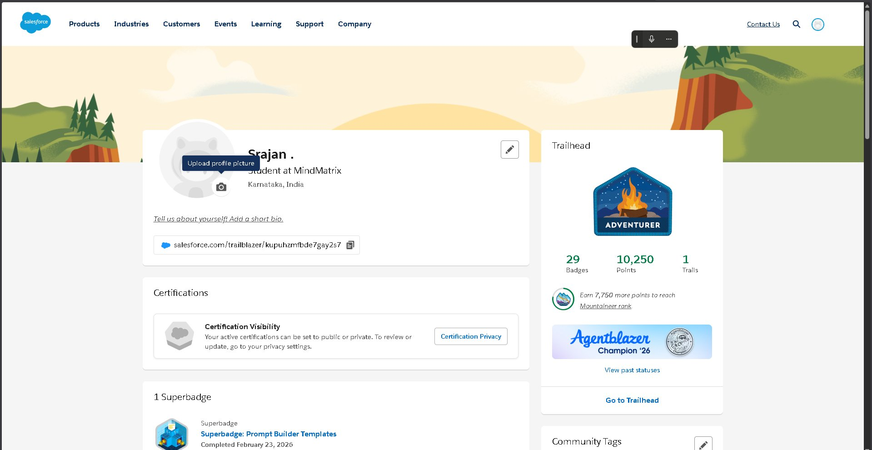
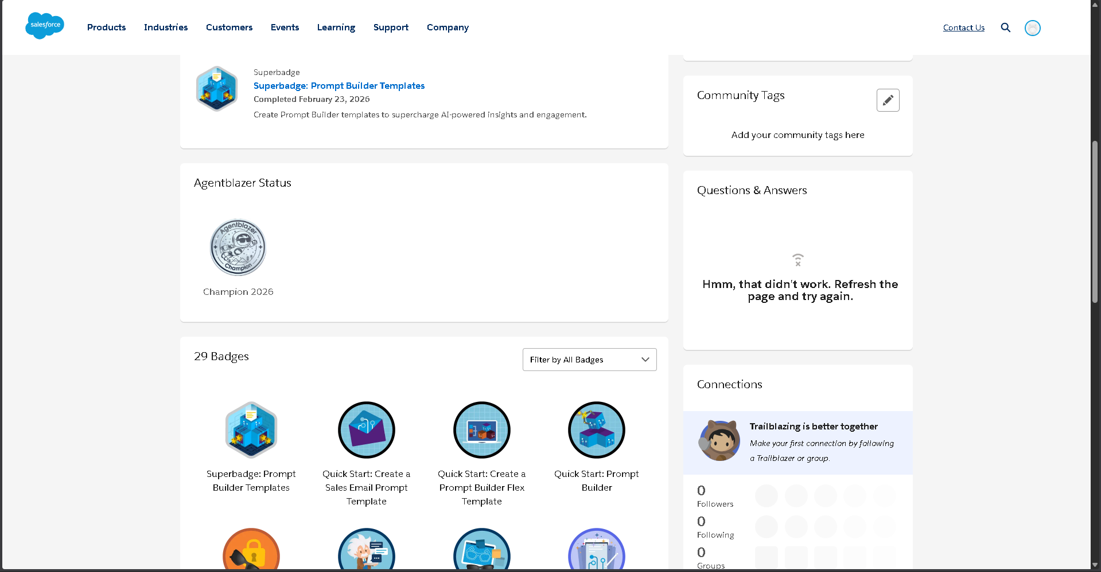
SALESFORCE TRAILHEAD & ANDROID DEVELOPMENT (GENERATIVE AI & ENTERPRISE PLATFORMS)
Achieved Adventurer rank on Salesforce Trailhead with 29 badges and 10,250 points, demonstrating expertise in enterprise AI and automation platforms. Completed Superbadge for Prompt Builder Templates, recognizing proficiency in creating AI-powered insights and custom prompt logic. Mastered the Agentforce ecosystem including Agent Planning, Builder Basics, and specialized implementations for Sales and Service platforms. Advanced training covered AI Strategy, Trusted Agentic AI, and Threat Modeling for secure, responsible AI deployment. Simultaneously, Android development training focused on Jetpack Compose integration, building responsive card-based UI layouts with seamless animations and Material Design 3 principles. Key learnings: Enterprise AI implementation, Agentforce ecosystem mastery, professional UI design patterns, and production-ready application development practices.

Slide 10
ANDROID PROJECTS (NETWORKING & CONCURRENT PROGRAMMING)
Race Tracker Application - Concurrency:
Mastered Kotlin Coroutines and concurrent programming by implementing parallel race simulation. Explored memory optimization using delay() functions and launch builders to prevent CPU blocking during asynchronous task execution. Successfully managed multiple threads efficiently for responsive user interfaces and learned practical concurrency patterns used in production applications.
Mars App - Internet Connectivity:
Focused on real-world data integration by fetching NASA Mars Rover API data. Implemented Retrofit library for REST API integration and Moshi JSON parser for robust data handling. Managed network states including loading, success, and error conditions with proper user feedback. Displayed real-time API data within Jetpack Compose UI, demonstrating practical connectivity patterns.
Key Learnings:
• Kotlin Coroutines for efficient asynchronous programming
• REST API integration and external service connectivity
• Network state management and error handling patterns
• Responsive UI implementation with real-time data updates

Slide 11
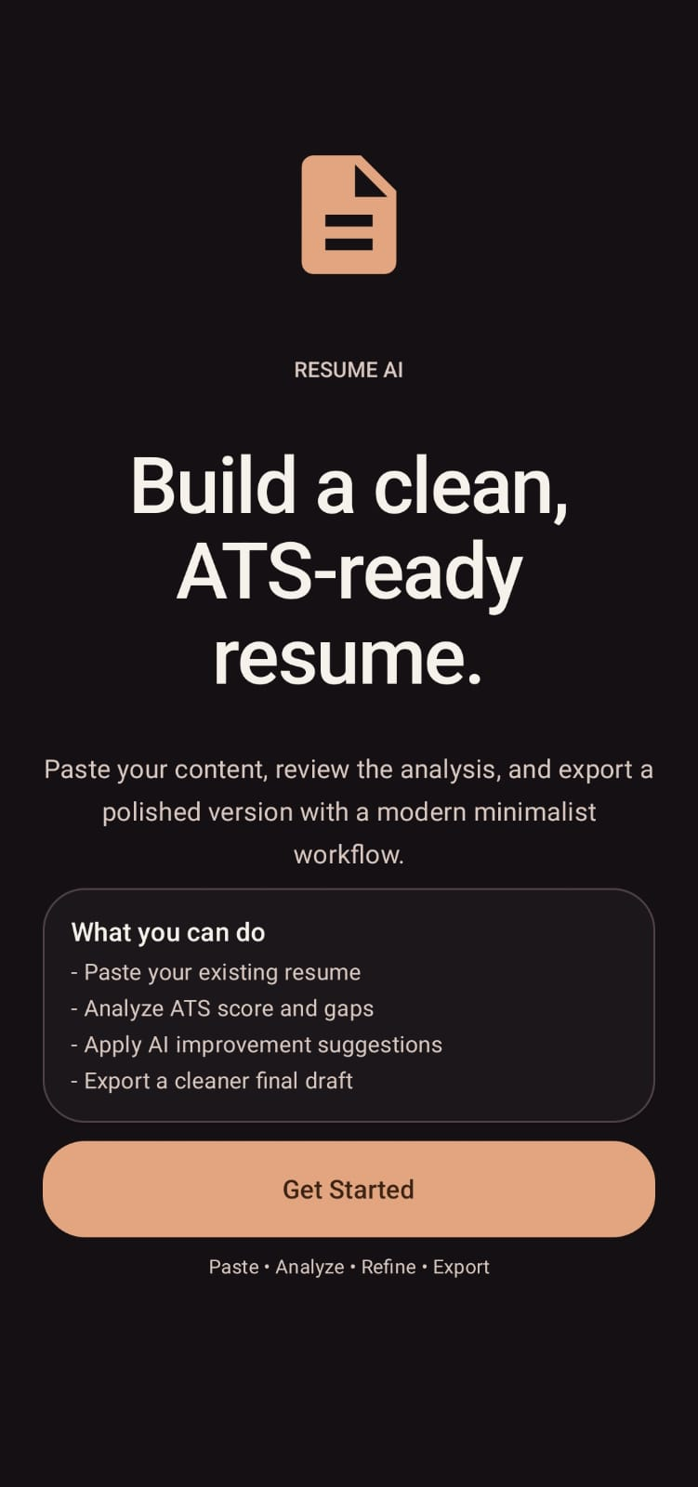
SIDE PROJECT: AI RESUME ANALYZER (INTEGRATING ALL LEARNINGS)
Developed a comprehensive AI-driven Resume Analyzer application combining Android development expertise with AI-powered analytics to solve real-world career challenges. The application enables users to select target roles (Android Developer, Data Analyst, etc.) and analyzes resume details including education, experience, certifications, and skills. The system provides a real-time ATS score out of 100 with detailed section-by-section analysis and intelligent keyword gap identification. Core feature: Keyword gap analysis identifies missing industry-specific terms like Kotlin, Jetpack Compose, and Retrofit, offering actionable recommendations for improvement. This project demonstrates integration of data analysis algorithms with Android UI/UX principles using Jetpack Compose. Integrated learning: Combines cloud infrastructure concepts, Generative AI insights, network API calls for data processing, concurrent programming for responsive performance, and professional UI design into a single production-ready application.

Slide 12
LEARNING OUTCOMES (TECHNICAL & PROFESSIONAL SKILLS)
Technical Skills Acquired:
• Strong proficiency in Kotlin fundamentals and advanced object-oriented programming
• Android Studio development with Jetpack Compose for modern UI design
• Kotlin Coroutines for concurrent programming and asynchronous task management
• REST API integration with Retrofit and JSON parsing with Moshi
• Google Cloud Platform infrastructure provisioning and management
• Generative AI implementation using Gemini and Google AI Studio
• Salesforce Agentforce ecosystem and enterprise AI solutions
Professional Skills Developed:
• Clear articulation of technical work in presentations and code reviews
• Effective technical documentation and communication skills
• Time management, task prioritization, and professional workplace conduct
• Collaborative teamwork and agile methodology understanding
• Version control practices (Git) and code quality discipline
• Detail-oriented documentation and continuous learning mindset
• Adaptability to changing requirements and persistent problem-solving

Slide 13
CONCLUSIONS
Industry Transition Success:
This internship successfully bridged the gap between academic theory and corporate practice, providing comprehensive understanding of real-world software development lifecycles and preparing for immediate contribution to professional development teams.
Technical Mastery Achieved:
• Demonstrated strong proficiency in Kotlin and Jetpack Compose through multiple production-ready applications
• Successfully implemented concurrent programming with Kotlin Coroutines for responsive, efficient applications
• Gained practical expertise in REST API integration and real-time data management
• Mastered Generative AI integration for intelligent feature development
• Developed cloud infrastructure knowledge through Google Cloud Platform and enterprise solutions
Holistic Professional Growth:
• Developed robust foundation combining technical expertise with essential soft skills
• Enhanced professional communication and collaborative problem-solving capabilities
• Built marketable portfolio demonstrating complete feature development from design to deployment
• Positioned for successful career transition to professional IT industry roles

Slide 14
REFERENCES & LEARNING SOURCES
Official Documentation & Platforms:
• Android Developer Official Documentation: https://developer.android.com/
• Google Android Codelabs: https://codelabs.developers.google.com/?cat=android
• Jetpack Compose Documentation: https://developer.android.com/jetpack/compose
• Kotlin Official Documentation: https://kotlinlang.org/docs/
Learning Platforms & Resources:
• MindMatrix LMS: https://lms.mindmatrix.io/
• Salesforce Trailhead: https://trailhead.salesforce.com/
• Google Cloud Platform: https://cloud.google.com/
• Google Cloud Console: https://console.cloud.google.com/
Project & Community Resources:
• Project Source Code Repository: github.com/Arjun-BS
• Android Studio IDE and debugging tools
• Stack Overflow Android community forums
• MindMatrix mentorship and peer learning community

